Slide 1
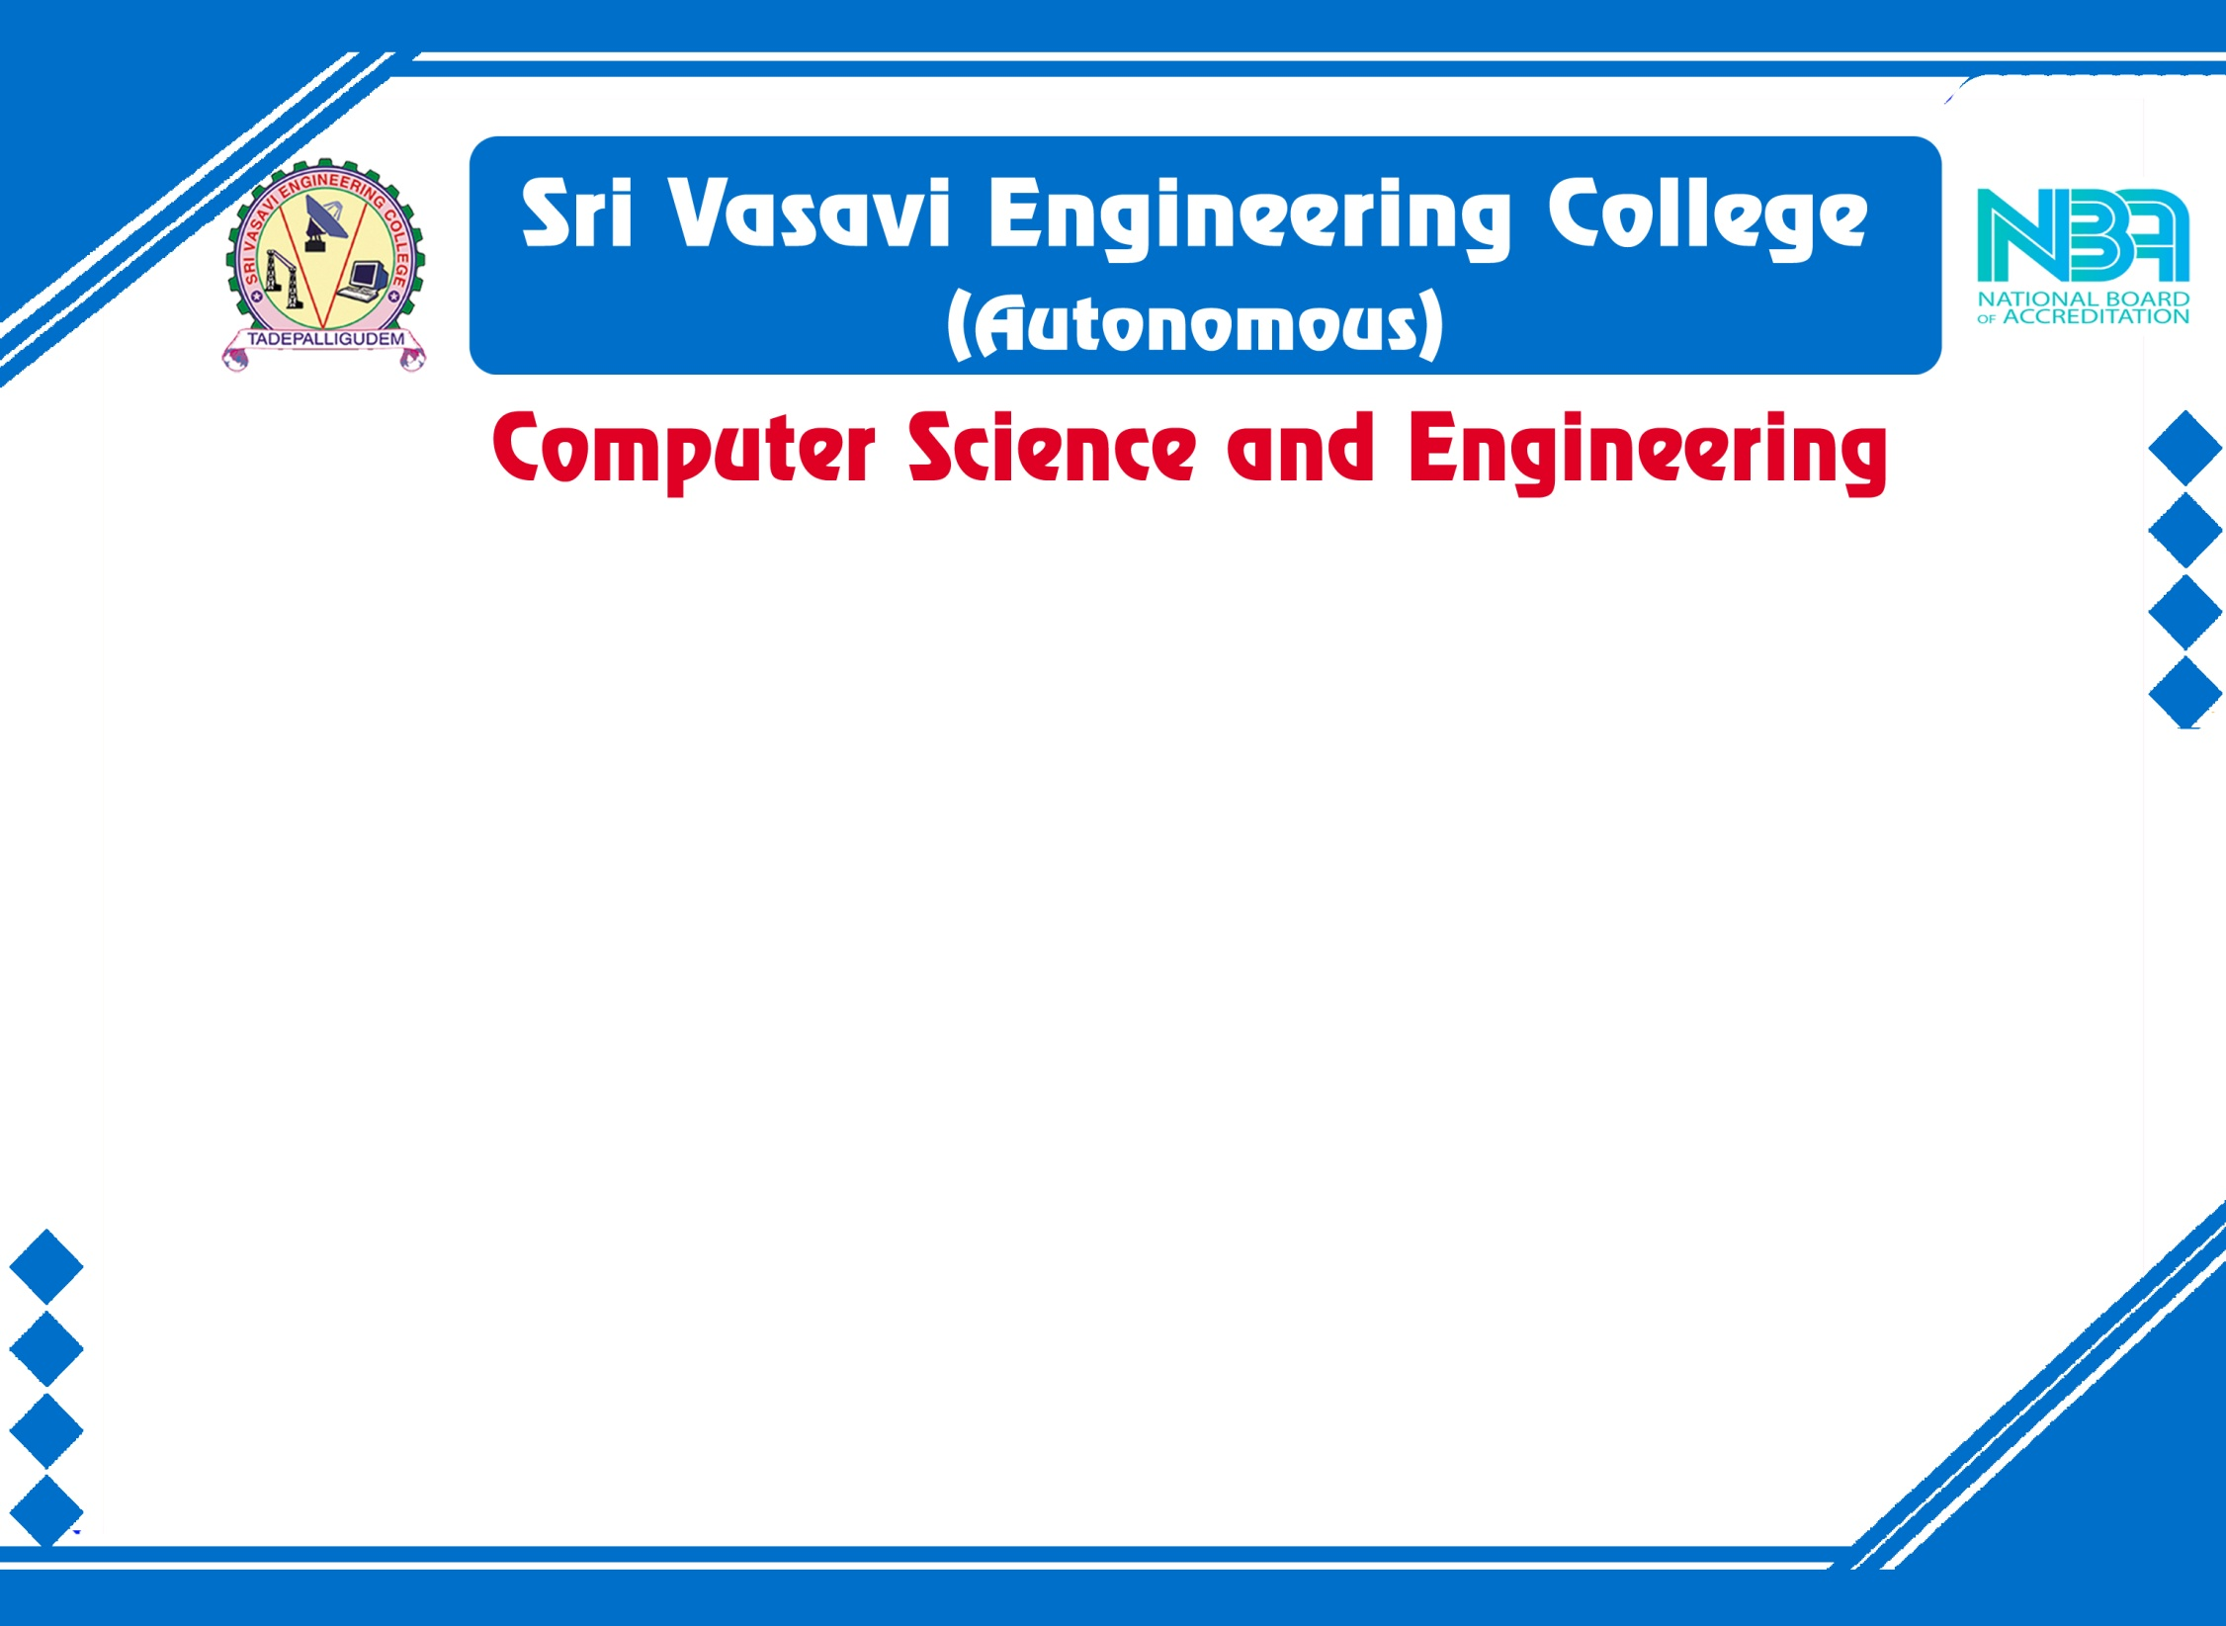

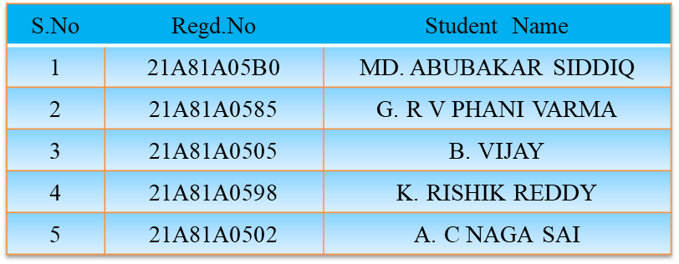
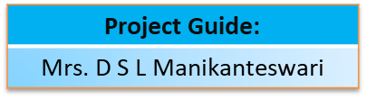
Main Project External Review
Batch No: 16
Project Title : Nutrient Recommendation System for Personalized Diet

Slide 2
Main Project External Review Contents
Abstract
Introduction
Literature Survey
Problem Statement in Existing System
Proposed System
Objectives
Project domain
Requirement analysis
- Functional Requirements
- Non-Functional Requirements
- Software Requirements
- Hardware Requirements

Slide 3
Main Project External Review Contents
System Architecture
Methodology
Project Plan
Design
Implementation
Result Analysis
Attainment of Objective
Conclusion
Future scope of project

Slide 4
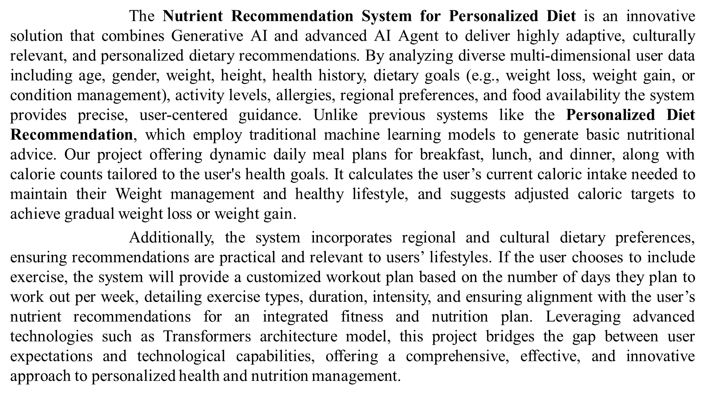
Abstract:

Slide 5
Introduction:
AI is transforming health and wellness with personalized nutrition and fitness recommendations. The Nutrient Recommendation System for Personalized Diet provides goal-oriented meal plans and workouts based on user inputs like age, gender, and dietary preferences. Using machine learning and AI agents, the system generates customized plans, ensuring a seamless and effective health management experience. Its scalable design allows future integration of advanced nutrition, fitness tracking, and wellness features, making it a powerful tool for personalized well-being.

Slide 6
Literature Survey:
S .No | Authors | Research paper | Published Year | Techniques used | Conclusion
1 | Asst Prof. Mrs. D. Navya Narayana Kumari, T. Praveen Satya, B. Manikanta, A. Phani Chandana, Y. L.S Aditya | Personalized Diet Recommendation System Using Machine Learning | February 2024 | Nearest Neighbor Algorithm Fast API Streamlit Standard Scaler Cosine Similarity. | Implemented software for diet and healthy living advice. Highlights the importance of nutritional counseling.
2 | Vijay Jaiswal | A new approach for recommending healthy diet using predictive data mining algorithm | March 2019 | Decision Tree Learning Algorithm Random Tree | The study shows that Random Tree works well on classification problems with non-repeated values. It considers factors like food preferences, fitness goals, and nutrient content to map daily menu planning.

Slide 7
S.No | Authors | Research paper | Published Year | Techniques used | Conclusion
3 | Butti Gouthami, Malige Gangappa | A Nutritional Diet Recommendation System Using User Interest | 2020 | USDA Nutrition Data Set BMI Calculation | Uses USDA nutrition database and user food intake to determine personalized diet recommendations.
4 | Rachel Yera Toledo, Ahmad A. Alzahrani, Luis Martinez | A Food Recommendation System Based on Nutritional Information and User Preferences | July 2019 | Optimization Techniques | Generates daily meal plans based on user preferences and nutritional data. Ensures diverse and optimized diet plans..

Slide 8
Problems In Existing system:
The current dietary and fitness planning systems rely on generic meal plans and workout routines that fail to account for individual differences such as age, allergies, and activity levels. Users often struggle with inaccurate calorie tracking and lack real-time adjustments to their dietary needs. Additionally, existing platforms lack integration between nutrition and fitness, making it difficult to align meal plans with workout goals. The absence of AI-driven personalization reduces user engagement and effectiveness, leading to unsustainable health habits. Addressing these limitations is crucial for improving accuracy, customization, and long-term adherence to health plans.

Slide 9
Proposed System:
The proposed Nutrient Recommendation System for Personalized Diet enhances dietary and fitness management through advanced AI-driven meal and workout customization. It leverages AI agents to generate dynamic, personalized meal plans based on factors like age, weight, dietary goals, and activity levels. Additionally, it integrates real-time calorie and nutrient tracking, ensuring precise dietary recommendations. The system also offers AI-generated workout plans tailored to individual fitness objectives, creating a seamless connection between nutrition and exercise. This holistic approach ensures optimal health management, making personalized wellness more accessible and effective.

Slide 10
Objective:
Personalized Dietary Recommendations and Dynamic Meal Planning:
The system leverages Generative AI and advanced AI Agents to create highly customized meal plans tailored to individual needs. It considers various factors such as age, gender, weight, height, dietary goals, activity levels, allergies, and budget to provide precise recommendations.
Additionally, it offers dynamic meal planning by generating daily meal plans for breakfast, lunch, dinner, and snacks, complete with calorie counts aligned with the user’s health goals. The system calculates current caloric intake and suggests adjusted targets for gradual weight loss or gain, ensuring a sustainable and effective dietary approach.
Customized Workout Plan:
Generates workout plans based on user-selected exercise frequency and fitness goals.
Provides details on exercise types, duration, and intensity aligned with dietary recommendations.

Slide 11
Project Domain:
Our project domain is Full stack
Frontend Development : This deals with everything that the user interacts with directly
Streamlit: A Python-based framework used to build intuitive and responsive user interfaces. It simplifies frontend development for data-driven applications without needing HTML/CSS.
Backend Development :
Python 3.11: The core programming language used to develop the backend logic.
CrewAI: Manages AI agents for automating tasks like personalized meal and workout plan generation.
LangChain + Groq API: Used for integrating large language models that generate diet and fitness suggestions based on user inputs.
XlsxWriter: A Python library used to export the generated plans (diet/workout) into formatted Excel sheets for offline access

Slide 12
Requirement Analysis :
Functional Requirements :
Personalized Diet & Nutrition Module : Generate meal plans based on age, weight, goals, allergies, activity level
Dynamic Meal Planning Module : Daily meal suggestions, Real-time calorie tracking, Nutrient analysis
Customized Workout Module : Suggest workout type, Set duration & intensity, Align with diet plan
AI-Powered Recommendation System : Adapt plans from user progress, Adjust based on feedback
Downloadable Excel Format : Export diet/workout plans, Allow offline use, Easy customization.

Slide 13
Non-Functional Requirements :
Usability
Performance
Scalability
Accuracy
Software Requirements :
Programming Language: Python 3.11
Libraries: crewai==0.100.1, streamlit==1.42.0, langchain-core==0.3.34, langchain-groq==0.2.4,XlsxWriter
Hardware Requirements:
System : Core i3 or above
RAM : 4GB or above

Slide 14
Methodology :
We used Agile model process for our project to start with initial set of software requirements
With the small set of requirements gathered , we initially started the project and worked with frontend which we treated it as our first step of project.
Then another step is taken as next iteration and start developing our project
This process involves:
Data Collection & Preprocessing
Model Training and Evaluation
Frontend Development (Streamlit - Based UI)
Backend Development & AI Integration
Excel Export & Report Generation

Slide 15
Project Plan:
Project Discussion
Project plan & Requirements
Gathering
Model Training
Integrating the code
Developing
AI Agents
Developing
Frontend
Testing
Deploying

Slide 16
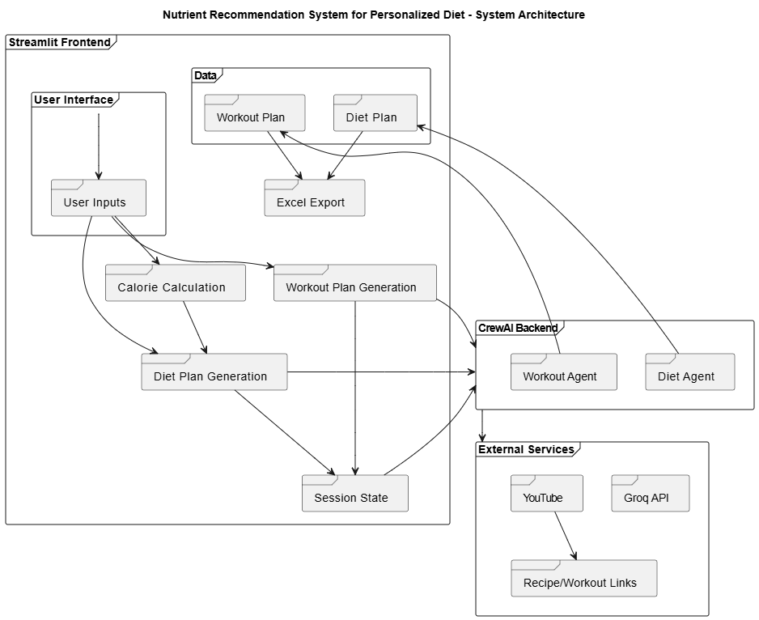
Design:
System Architecture:

Slide 17
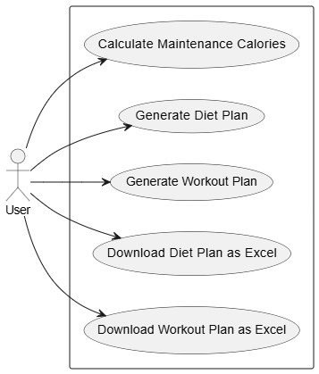
Use Case Diagram:

Slide 18
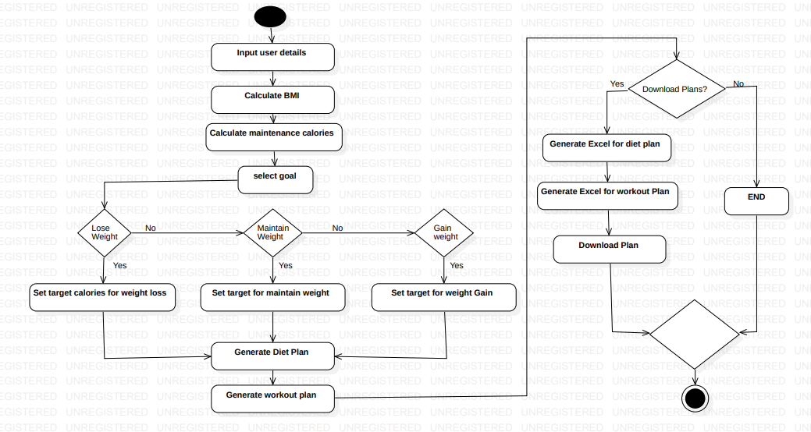
Activity Diagram:

Slide 19
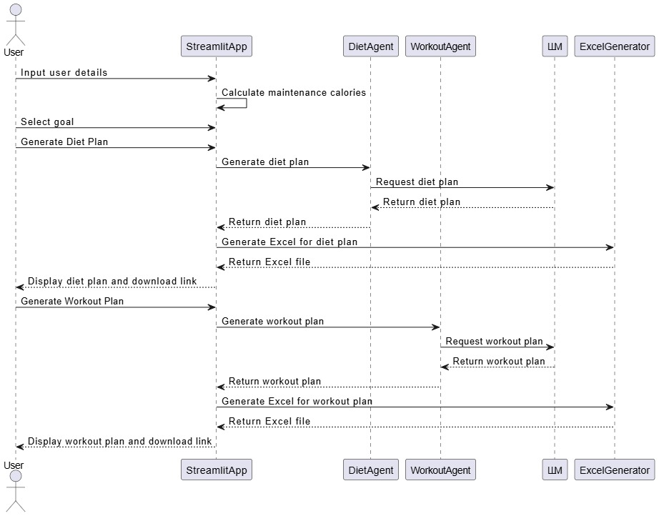
Sequence Diagram:

Slide 20
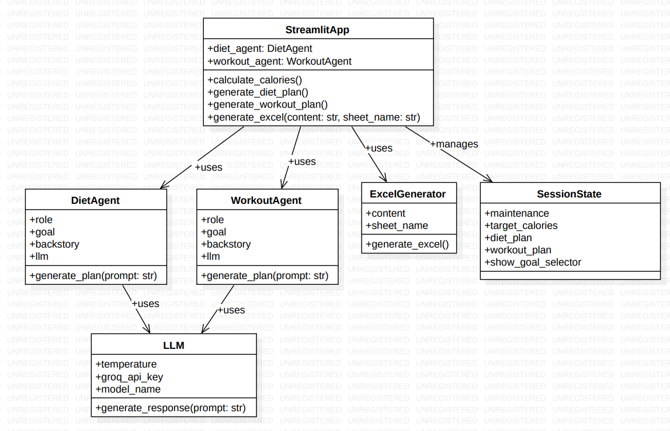
Class Diagram:

Slide 21
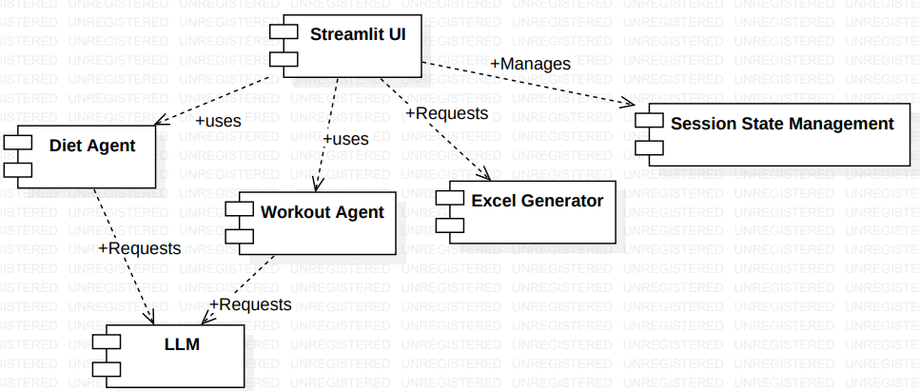
Component Diagram:

Slide 22
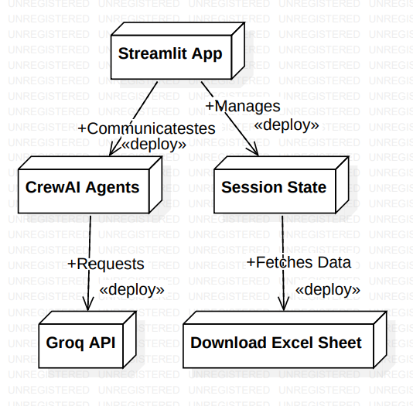
Deployment Diagram:

Slide 23
Implementation:
Files used for project implementation are:
requirements.txt
streamlit_app.py
Step 1: Setting Up Your Development Environment. Install the required dependencies in your project directory: pip install streamlit, crewai, langchain_groq, xlsxwriter. Choose a code editor like VS Code or PyCharm. Create a new Python file, e.g., app.py, to begin development.
Step 2: Building the User Interface (UI)Create a landing page with a welcome message and project introduction. Design input forms for users to enter their details (age, weight, height, goal, etc.).Add a tabbed navigation to switch between: Diet Plan, Workout Plan, Export to Excel. Use Streamlit components like st.text_input(), st.selectbox(), and st.button() for UI interactions.

Slide 24
Step 3: Integrating AI for Meal & Workout Plans Set up Groq API for AI-generated plans using langchain_groq. Define CrewAI Agents for: Meal plan generation, Workout plan generation, Configure CrewAI. Tasks to generate personalized results based on user input.
Step 4: Exporting Plans to Excel, Use xlsxwriter to format and save meal/workout plans in Excel.
Add a download button for users to save their plans.
Step 5: Deployment Test the app locally using: streamlit run app.py
Deploy the project using Streamlit Cloud

Slide 25
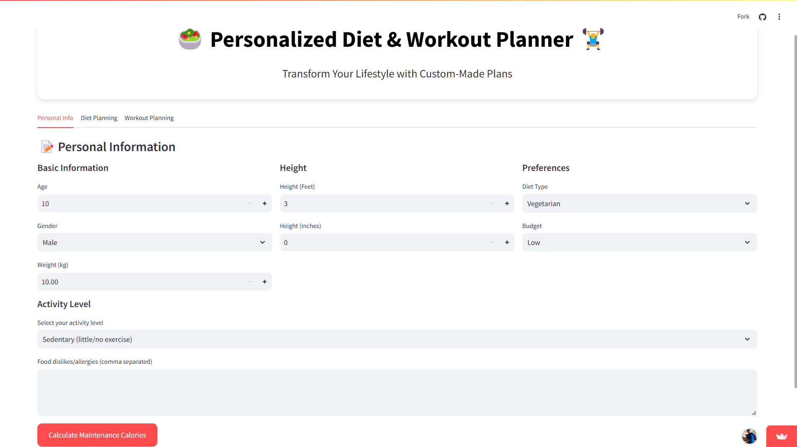
Result Analysis:
Home Page

Slide 26
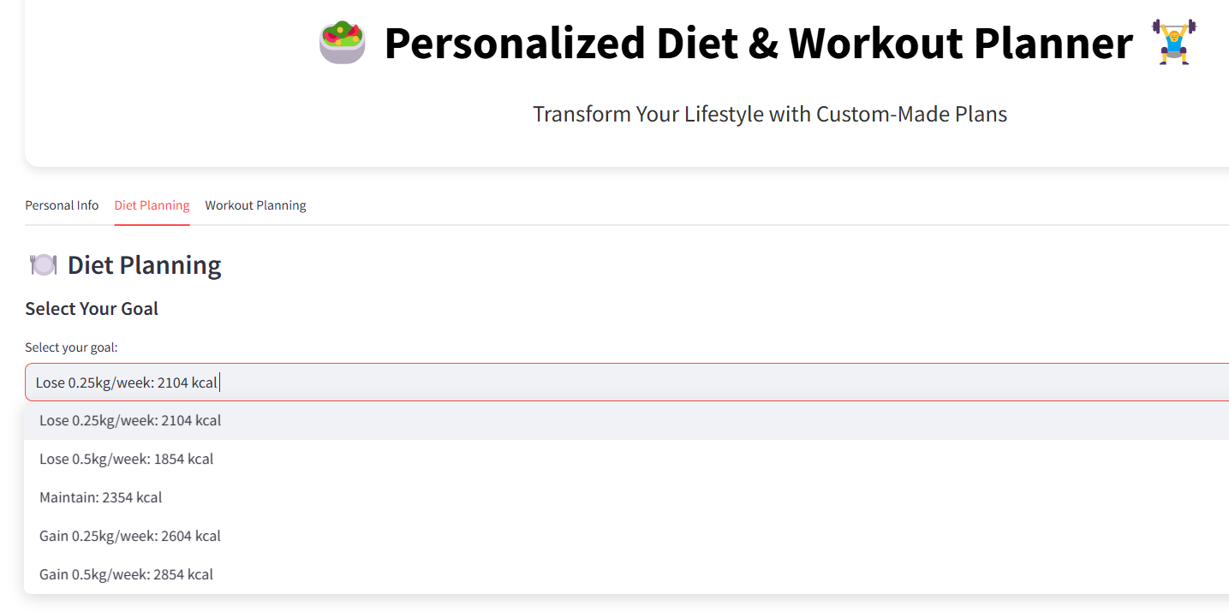
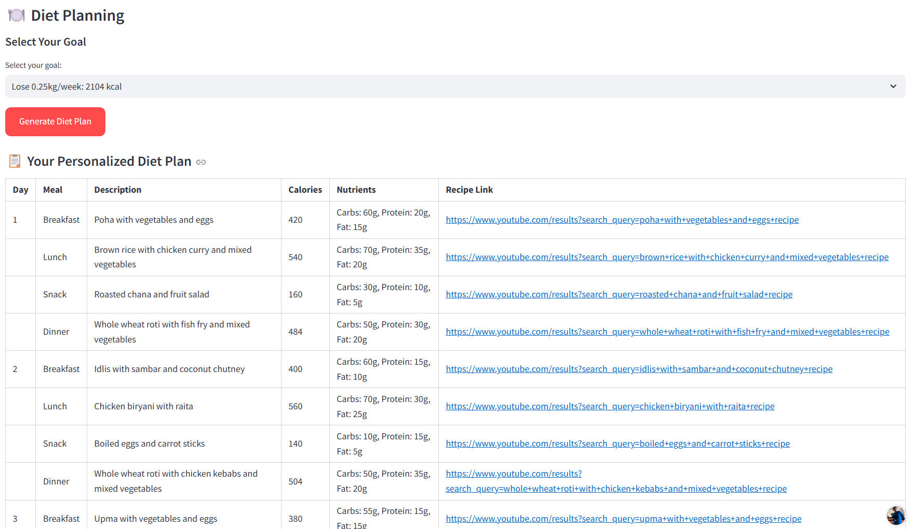
Diet Plan Goal Selection Page Diet Plan Generation Page

Slide 27
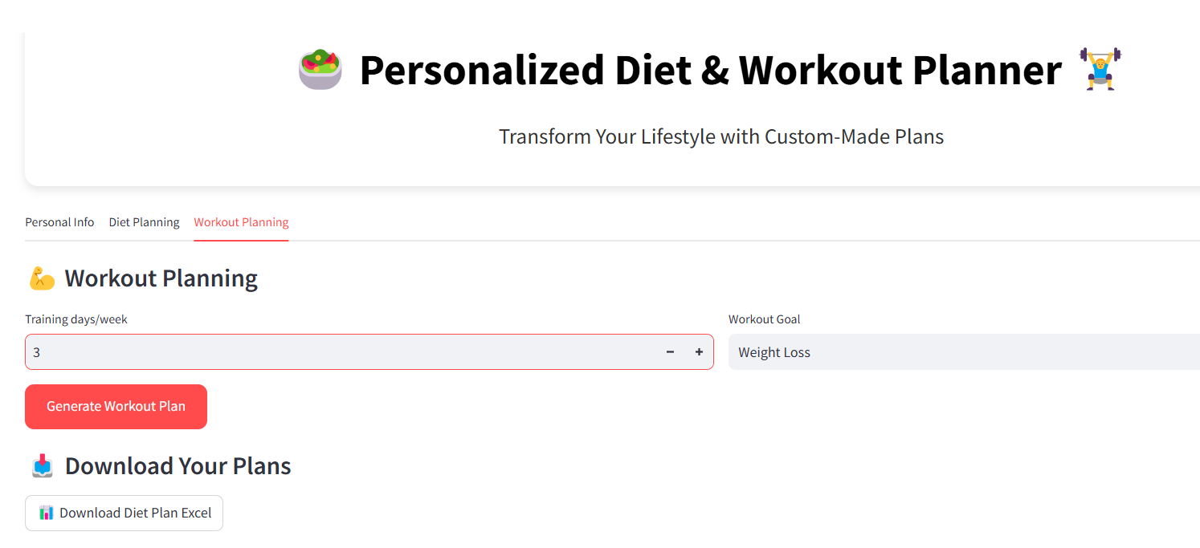
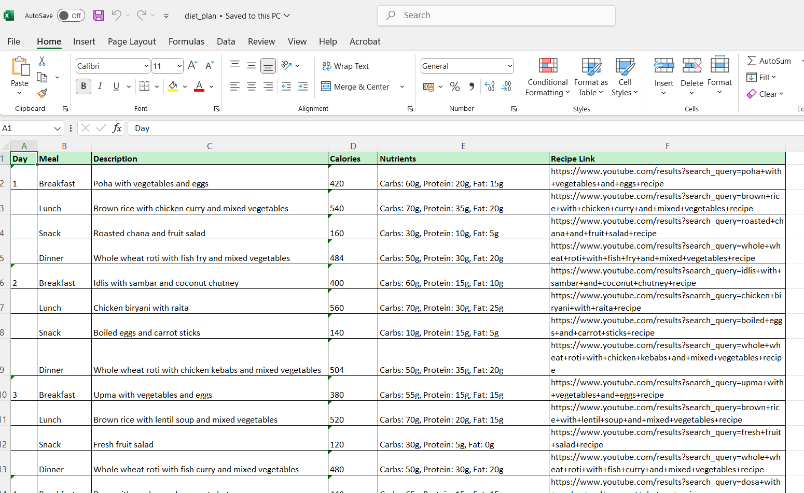
Diet Plan Excel Sheet Page Workout Plan Selection Page

Slide 28
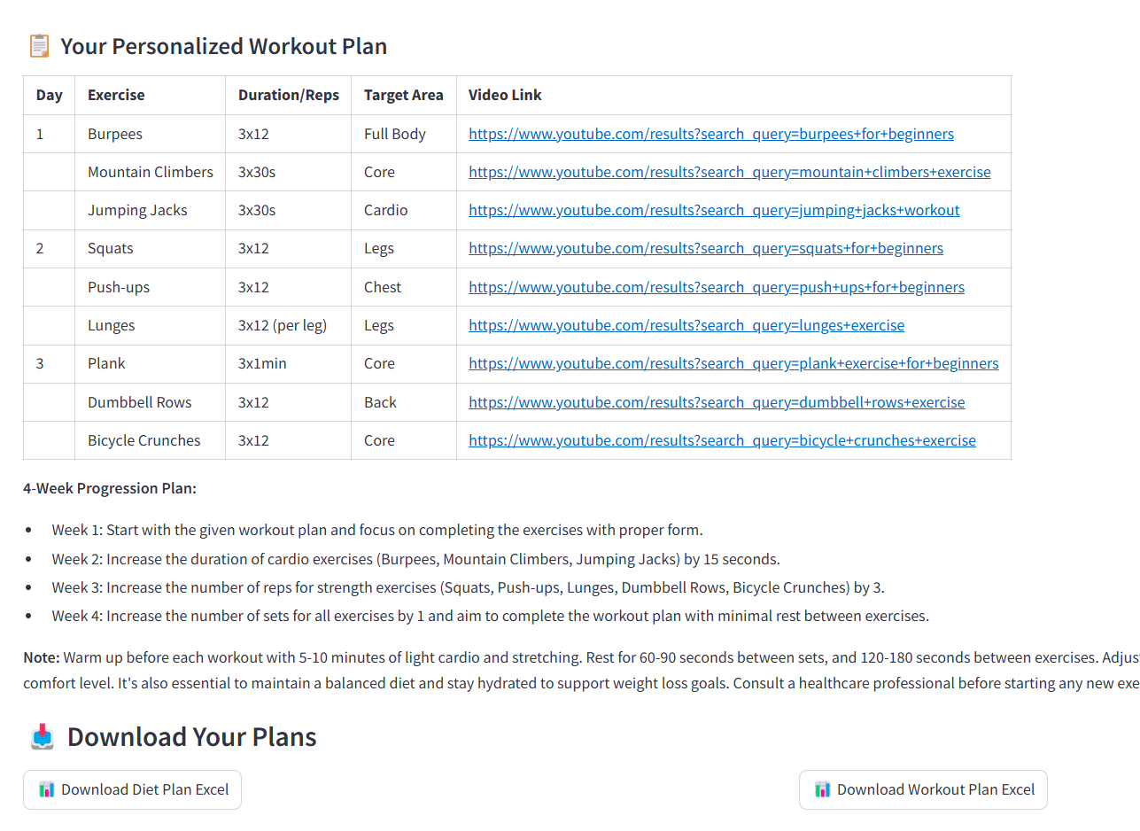
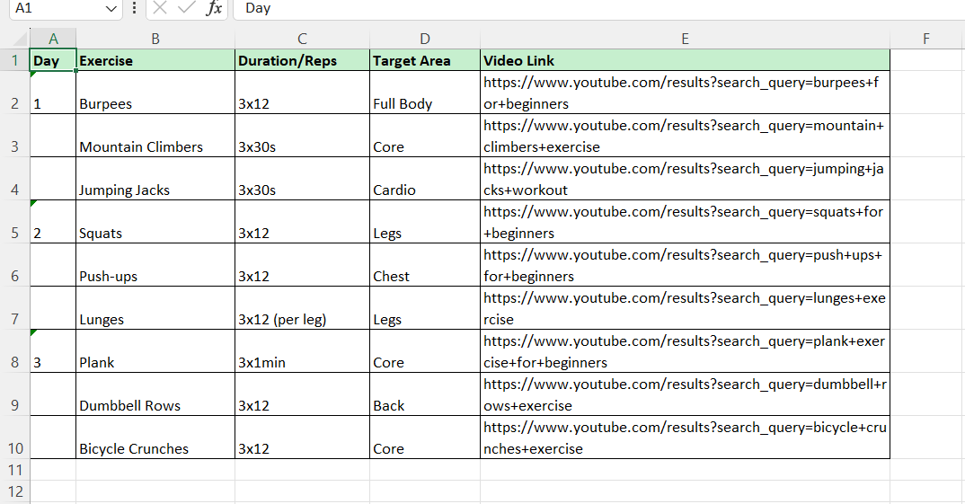
Workout Plan Generation Page Workout Plan Excel Sheet Page

Slide 29
Fast & Efficient: Provides real-time AI-generated diet and workout plans with minimal processing delay.
User-Friendly: Intuitive interface with easy-to-use tabs, dropdowns, and buttons for seamless navigation.
Highly Personalized: Generates customized meal and workout plans based on user input, preferences, and goals.
AI-Powered Automation: Uses CrewAI and Groq API to automate meal planning and workout scheduling.
Secure & Reliable: Ensures API key security and follows structured data processing for accurate results.
Time-Saving: Automates calculations and plan generation, reducing manual effort significantly.
Data Export Capability: Allows users to download their plans in Excel format for offline access.

Slide 30
Attainment of objective
Personalized Diet & Workout Planning – Successfully automated the generation of customized diet and workout plans based on user inputs such as age, weight, activity level, and goals, reducing manual effort in fitness planning.
Improved Accuracy & Efficiency – Leveraged AI to ensure precise calorie calculations, balanced meal distributions, and structured workout plans, optimizing health outcomes.
Seamless Data Export & Accessibility – Enabled users to download personalized plans in Excel format using xlsxwriter, facilitating easy access and tracking of fitness goals.
Security & Privacy Compliance – Ensured secure handling of user data by managing API keys through Streamlit secrets and environment variables, maintaining privacy and confidentiality.

Slide 31
Future scope of Project:
Integration with Wearable Devices.
Advanced Analytics.
Expansion of Crew AI Agents.
Voice Assistant Integration.
Expansion of Regional Preferences.

Slide 32
Conclusion:
This project is a Nutrient Recommendation System for Personalized Diet that uses Crew AI agents to generate personalized diet and workout plans based on user inputs. The app allows users to input their age, height, weight, gender, diet type, activity level, and food dislikes to receive a customized diet plan. Additionally, users can select their workout goal and generate a workout plan. The app also provides the option to download the generated plans in Excel format.

Slide 33


